Slide 1

Analisi dei diversi Robot: Ogni macchina racconta un capitolo dell’innovazione
Francesco Greco
Centro Dipartimentale di Chirurgia Endocrina e dell’Obesità, U.O.C. Chirurgia Endocrina e Metabolica, Fondazione Policlinico Universitario Agostino Gemelli IRCCS, Roma
Direttore Prof. Marco Raffaelli

Slide 2
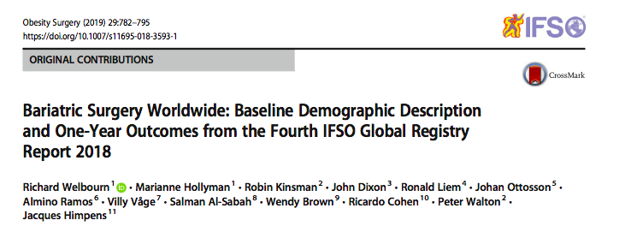
99.3% of all operations were performed laparoscopically

Slide 3
Advantages
Precision
Surgeon’s comfort
Learning curve
Remote Surgery
Disadvantages
Costs
Operative time
Training

Slide 4
Advantages in robotic bariatric surgery
Easy and fine dissection (Reoperation/Difficult cases)
Improved ergonomics against a thick and heavy abdominal wall (Superobese)
Avoidance of surgeon fatigue and torque
Prevention of instruments bending
Maintenance of working space (robotic arms)
Facilitation of completely hand-sewn anastomoses

Slide 5
Costs:
Surgical devices
Total hospital costs of the robotic procedures
Initial expense
Increased Operative Time:
Docking times
Hand sewing instead of stapling gastrojejunal anastomoses
Depending on the familiarity of the assistant, the need for instruction may be a factor in increased operating room
Li, Kun, et al. "Robotic versus laparoscopic bariatric surgery: a systematic review and meta-analysis." Obesity surgery 26.12 (2016): 3031-3044.
Veilleux, Eric, Jaime Ponce, and Rami Lutfi. "A Review of the Role of Robotics in Bariatric Surgery: Finding Our Future?." Journal of Laparoendoscopic & Advanced Surgical Techniques(2019).

Slide 6
ROBOTIC BARIATRIC SURGERY
Training:
Learning curve for the robotic platform is not limited to the surgeon's training only, but must include the entire team in the operating room. (Including scrub nurses, ancillary assistants who bring in the surgical cart, the bed‐side assistant, as well as the anesthetists)
Depending on the familiarity of the assistant, the need for instruction may be a factor in increased operating room times with the robot. (An example of this is with the stapling of a gastric sleeve or bypass anastomosis. Placement of the stapler relies on surgeon instruction to the assistant, which may increase times depending on the famil- iarity of the individual)
Jung, Minoa K., et al. "Robotic bariatric surgery: a general review of the current status." The International Journal of Medical Robotics and Computer Assisted Surgery 13.4 (2017): e1834.

Slide 7
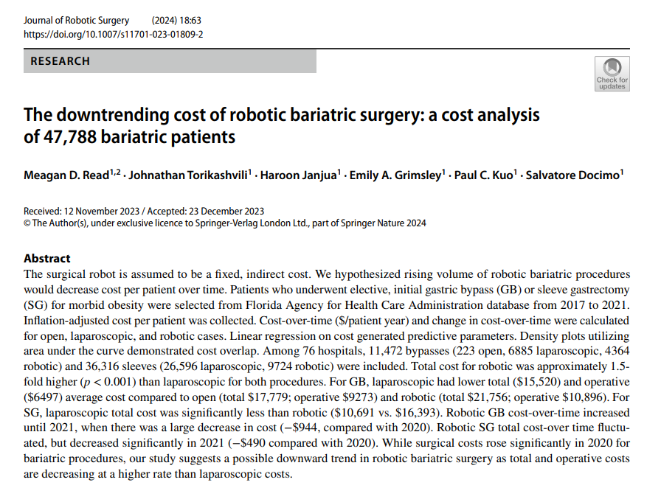
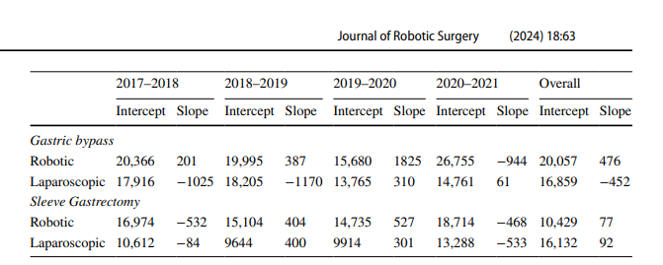
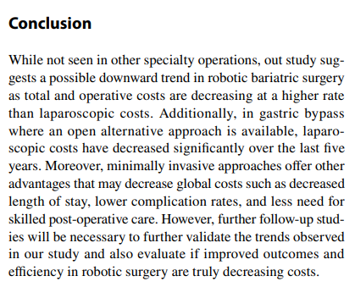
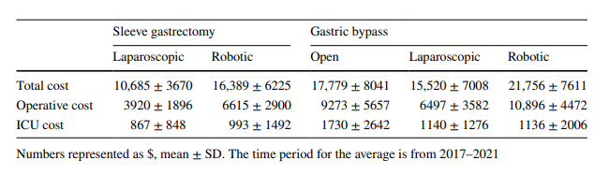

Slide 8
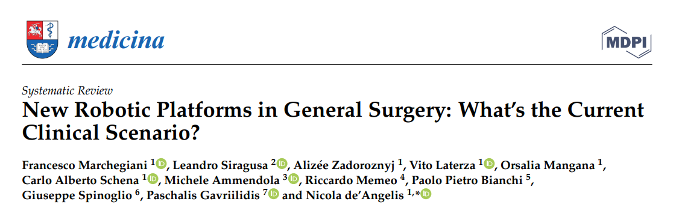
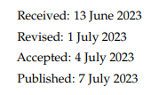

Slide 9
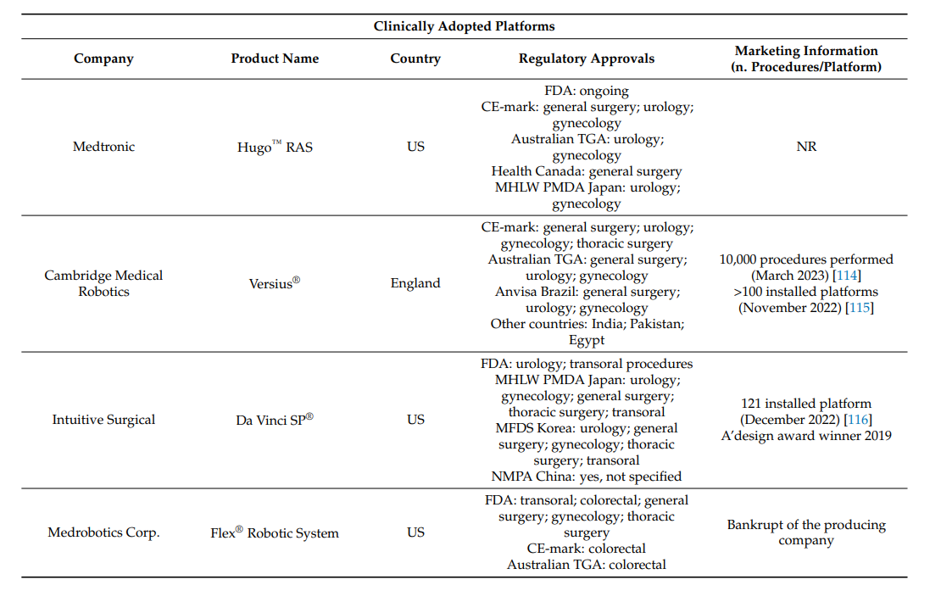
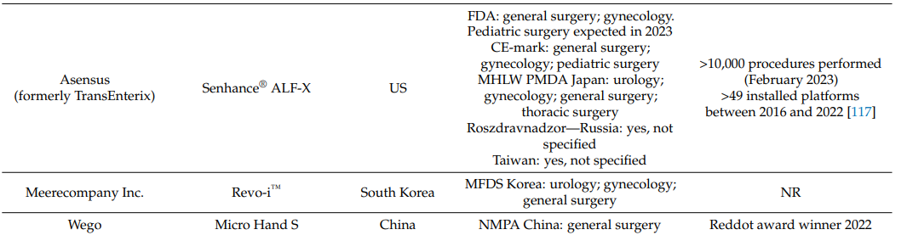

Slide 10
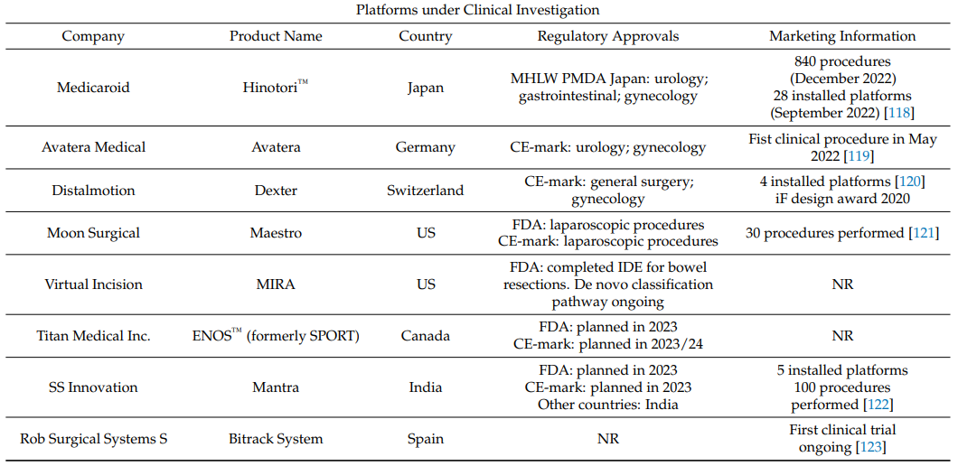

Slide 11
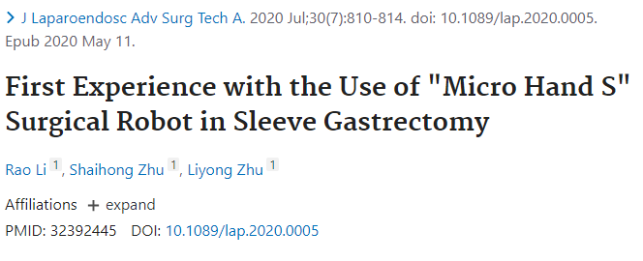
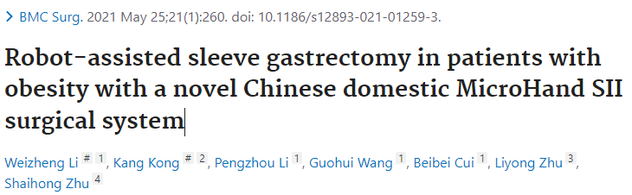
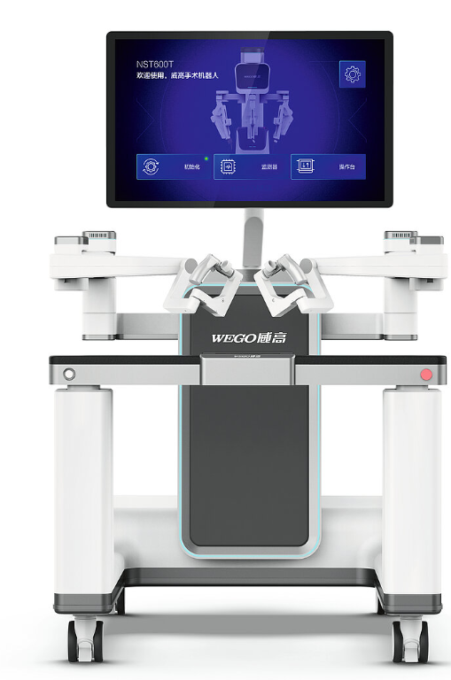
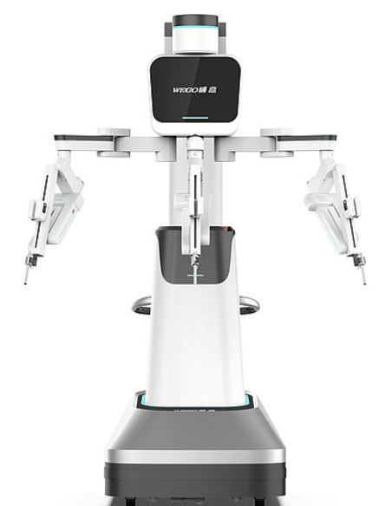
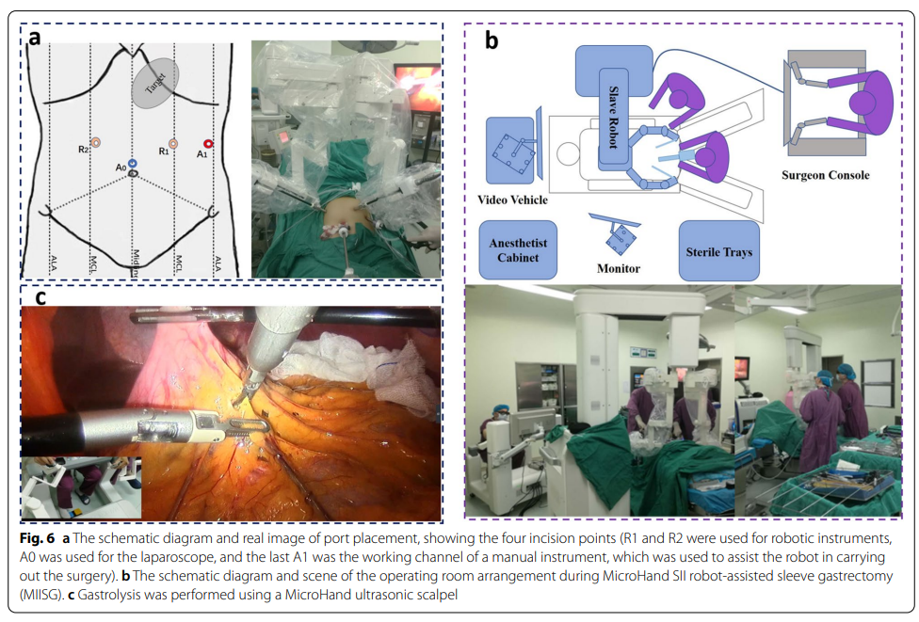

Slide 12
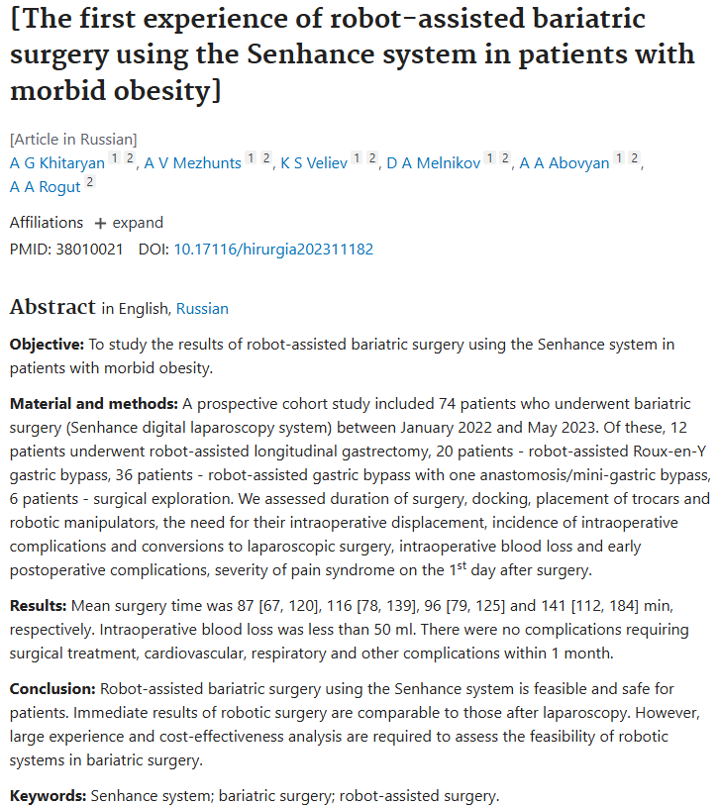
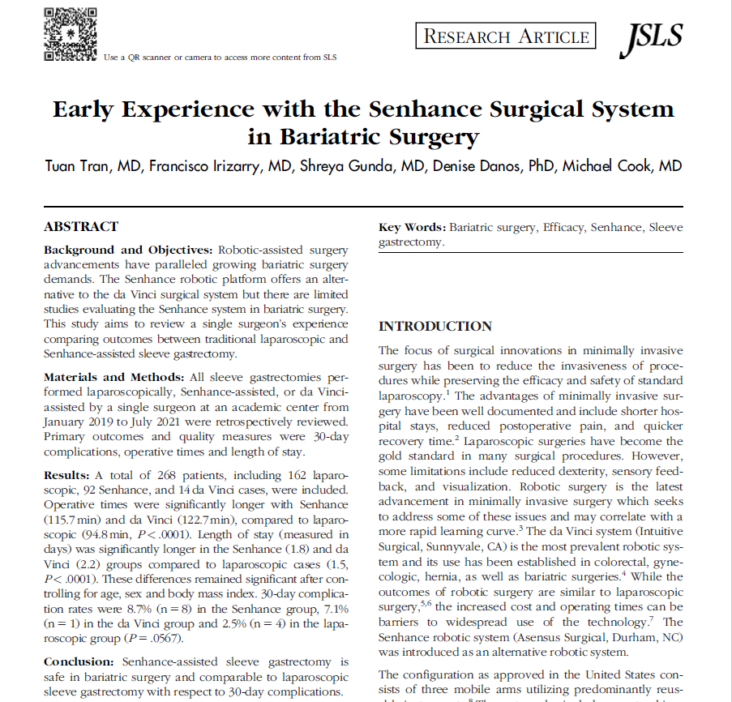
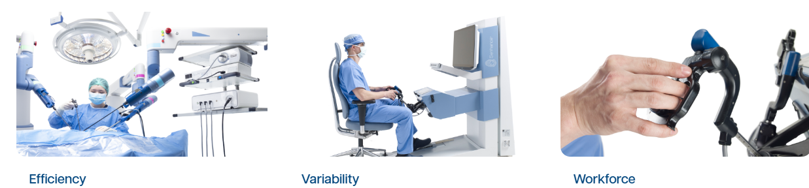

Slide 13
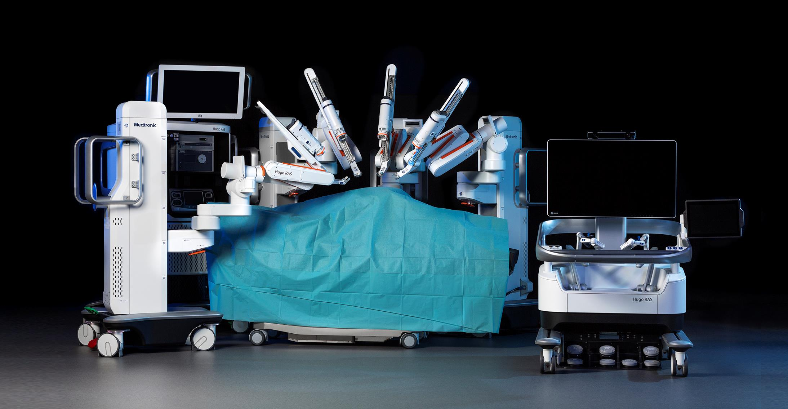
Console aperta (display HD-3D widescreen da 32 pollici con occhiali dedicati)
Quattro carrelli porta-braccio indipendenti
Impugnature che simulano l'impugnatura a pistola
Pannello a pedale per il controllo della telecamera, delle fonti di energia e del braccio di riserva
Una Karl Storz 3D Tipcam S™ racchiusa in un adattatore robotico fornisce la visione endoscopica

Slide 14
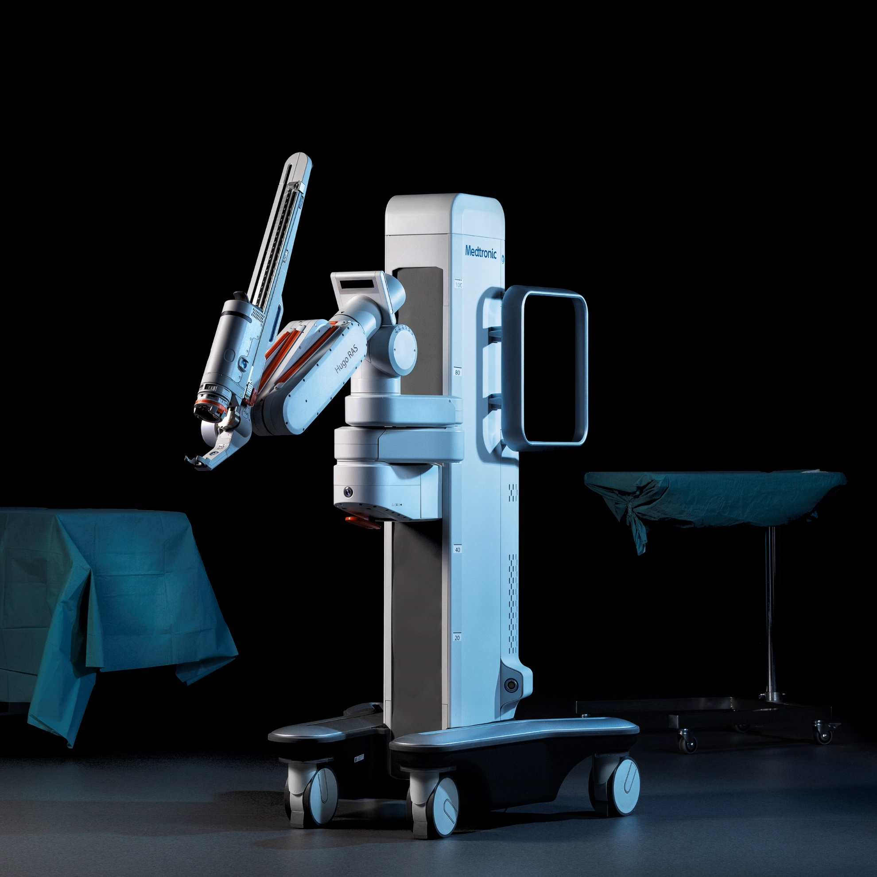
Introducing HugoTM – A new era in robotic-assisted surgery
Il design modulare consente ai chirurghi di scegliere l'approccio chirurgico più adatto a ciascun paziente:
Configurazioni a tre e quattro bracci per la chirurgia robotica
Configurazione a un braccio per supportare le procedure laparoscopiche standard
Ogni braccio robotico è indipendente ed estensibile grazie a 6 diverse articolazioni.

Slide 15
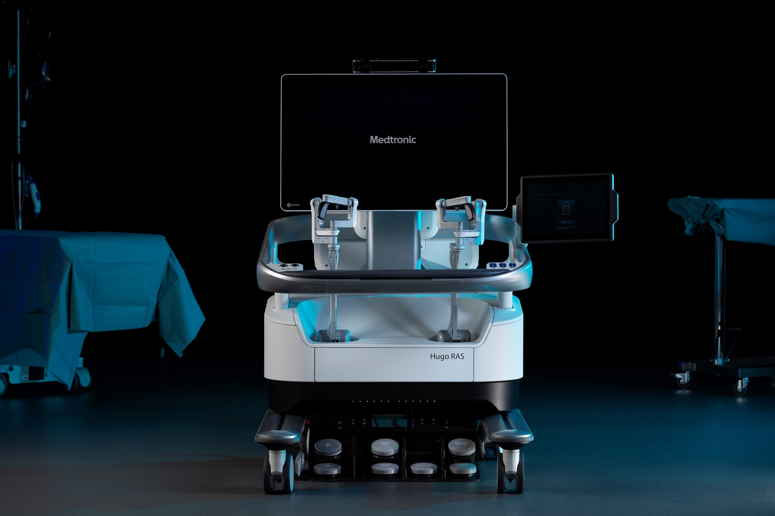
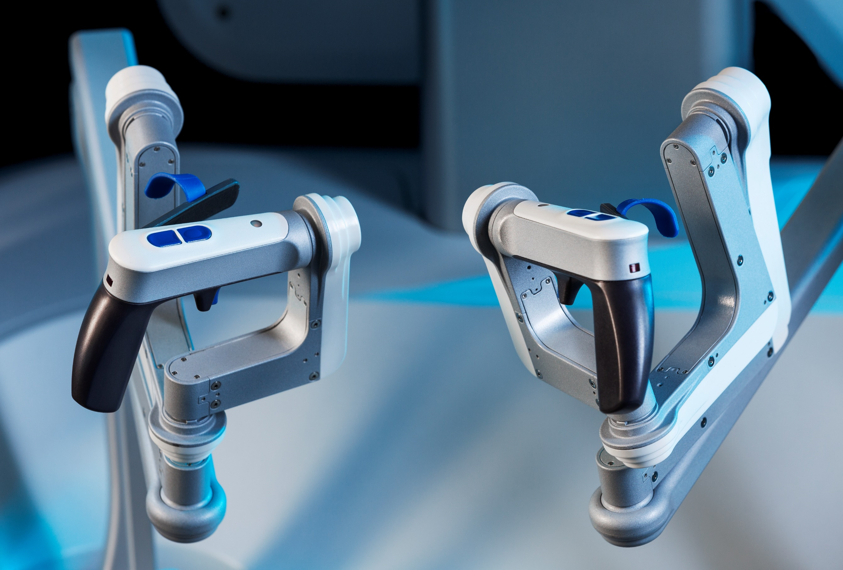
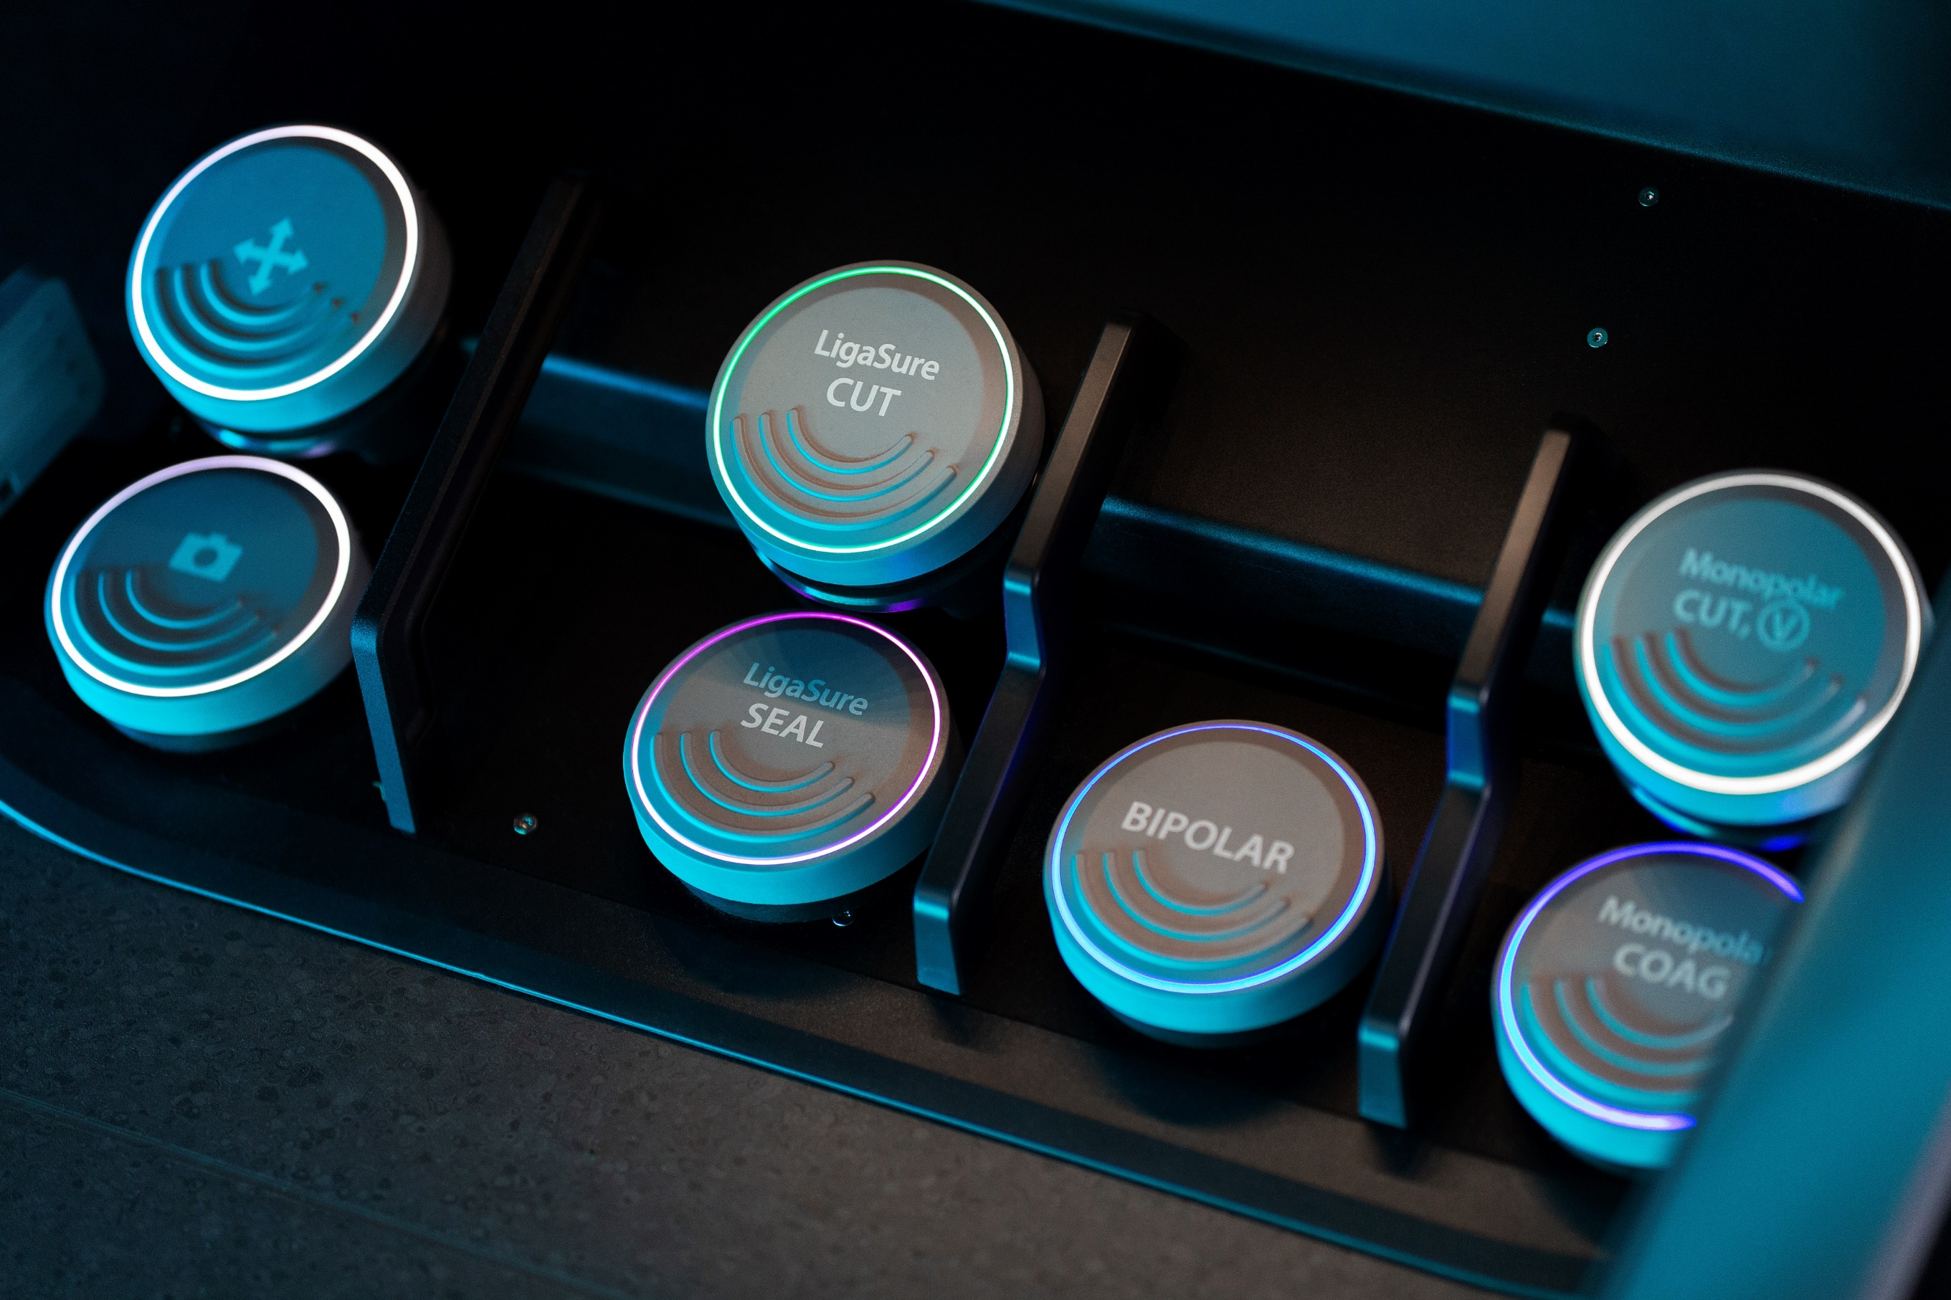
Introducing HugoTM – A new era in robotic-assisted surgery
Console chirurgica Hugo™
La console aperta semplifica la comunicazione tra l'équipe chirurgica e massimizza il comfort, offrendo al contempo:
Schermo panoramico da 32 pollici - Visione 3D HD
Controller ergonomici e un pannello a pedale per controllare la telecamera, le fonti di energia e il braccio di riserva.
Adattabilità alle preferenze di ogni chirurgo
Compatibilità con il simulatore di attività Hugo™ per la formazione virtuale

Slide 16
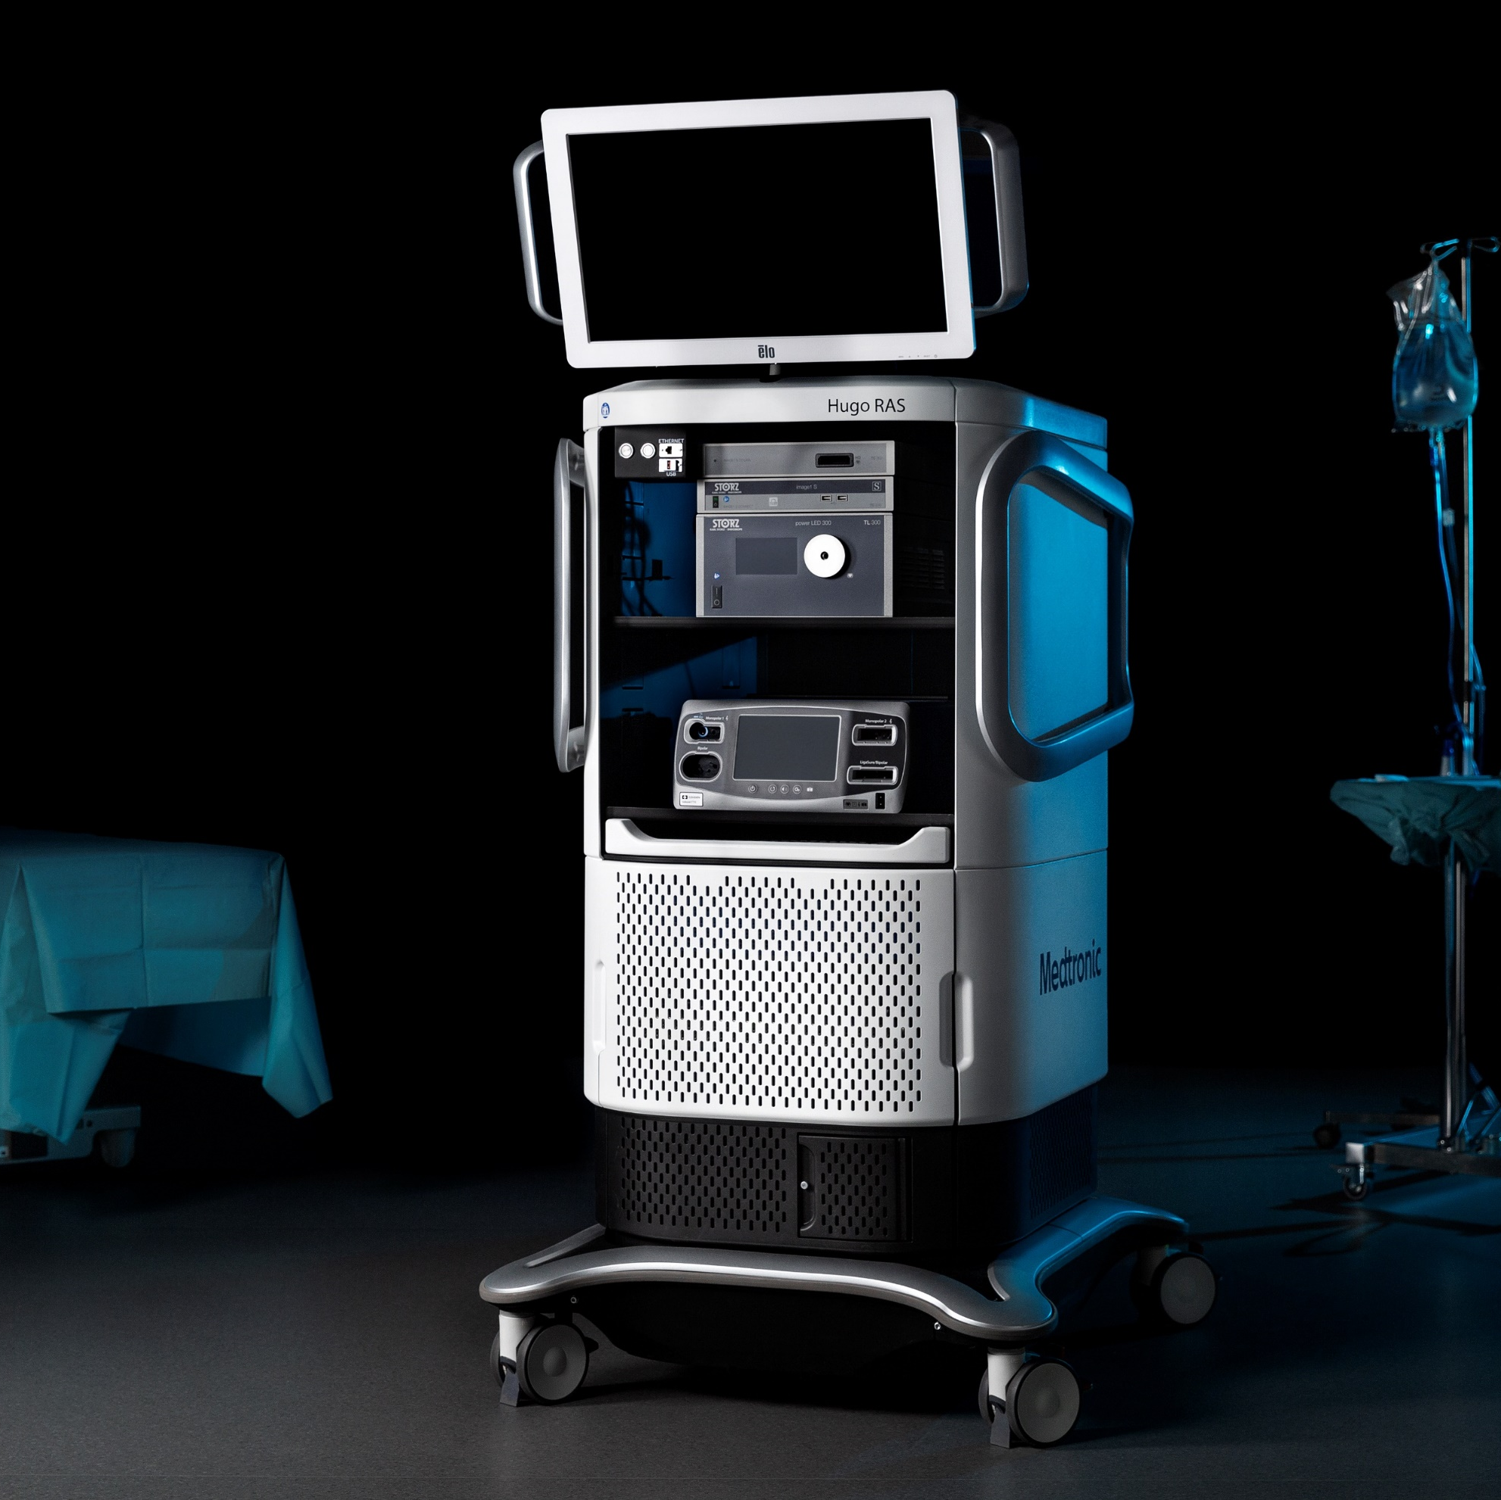
Introducing HugoTM – A new era in robotic-assisted surgery
Torre Hugo™
Dotata di KARL STORZ™ TIPCAM S 3D, la torre Hugo™ RAS offre:
Endoscopio 3D HD posizionabile su qualsiasi braccio robotico
Modalità di miglioramento dell'immagine esclusive per facilitare l'identificazione di strutture critiche
Piattaforma energetica Valleylab™ FT10
Compatibilità con la piattaforma di gestione e analisi video Touch Surgery™ Enterprise

Slide 17
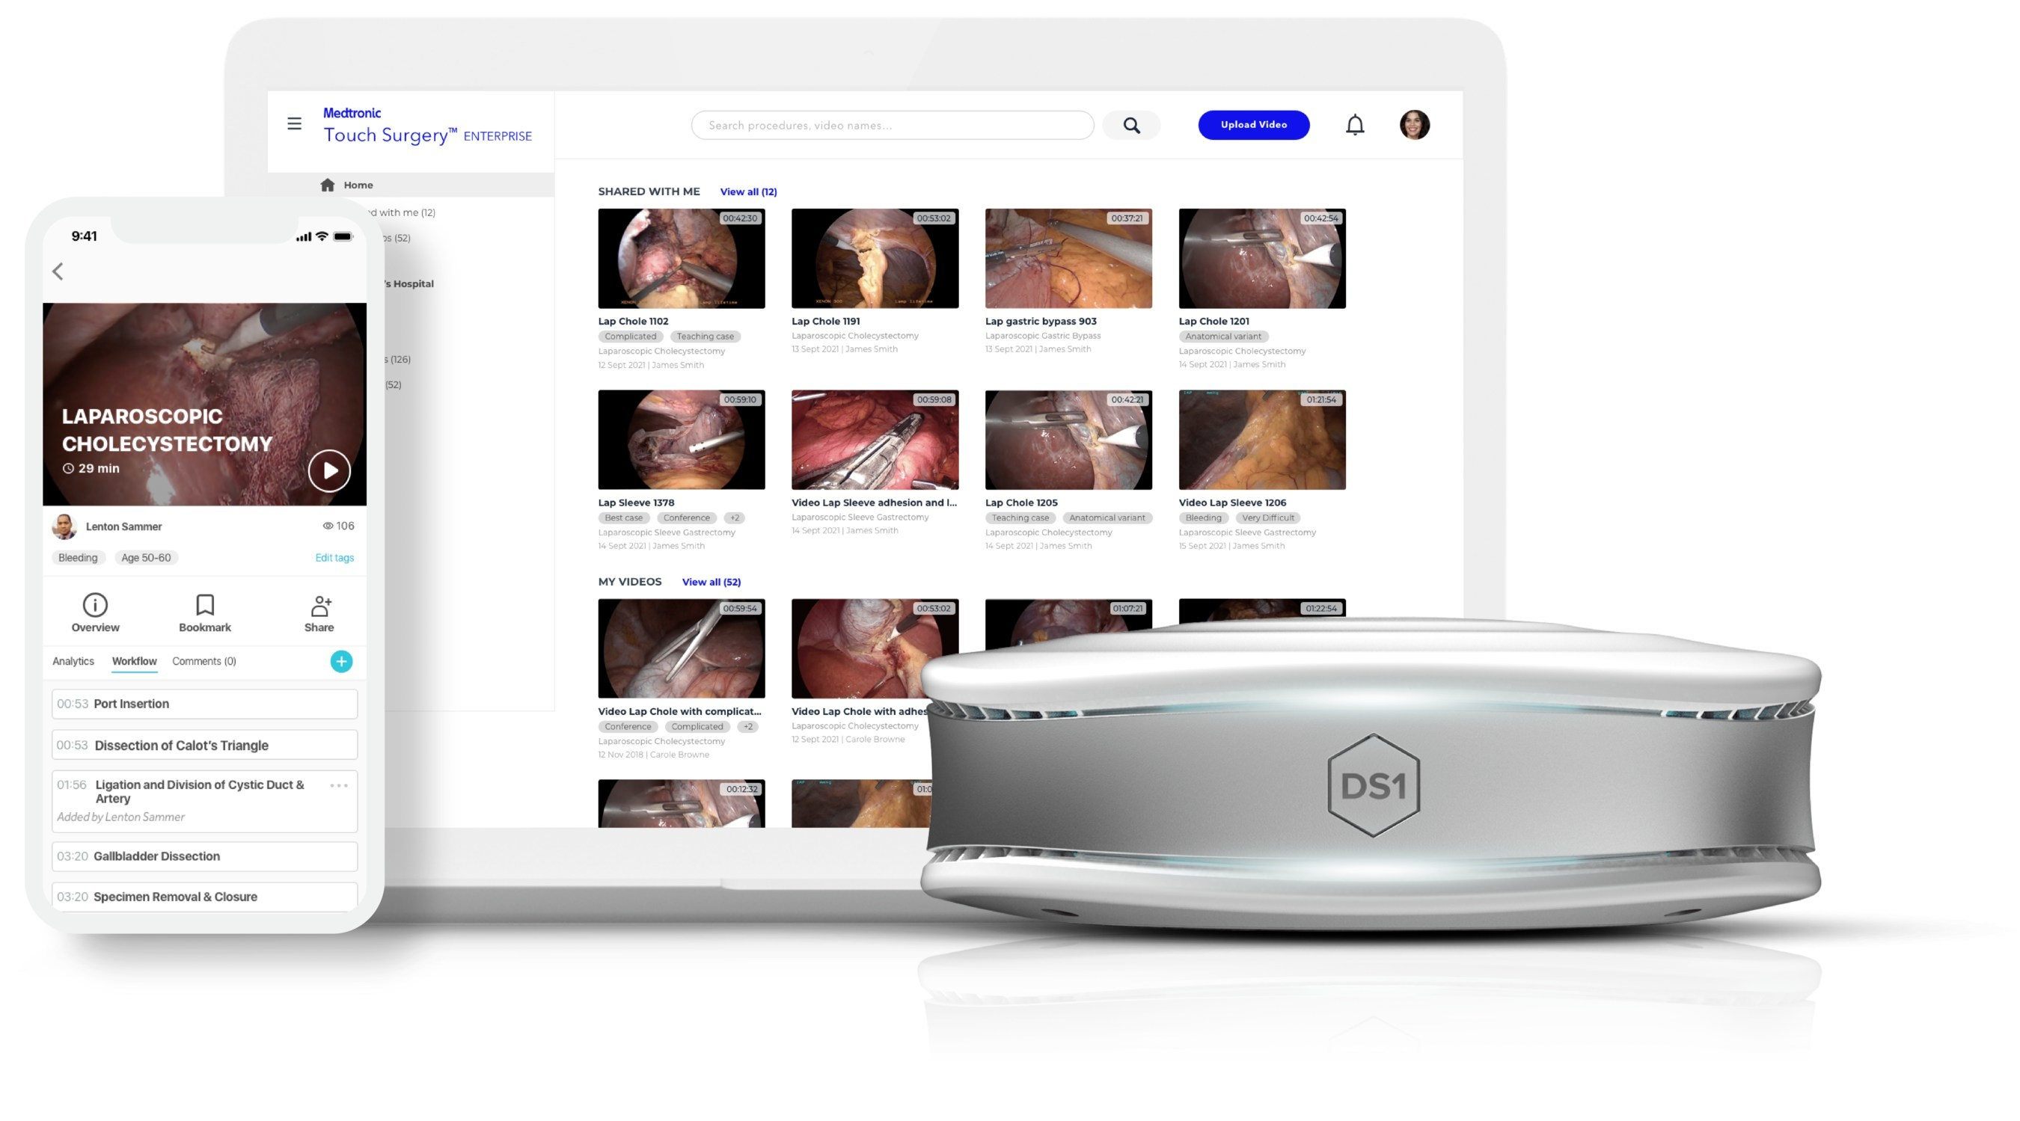
Introducing HugoTM – A new era in robotic-assisted surgery
Touch Surgery™ Enterprise
La prima piattaforma di analisi e video chirurgici basata sull'intelligenza artificiale per la sala operatoria
Carica automaticamente i video chirurgici senza bisogno di chiavette USB, DVD o unità crittografate
Compatibile con la maggior parte dei sistemi robotici laparoscopici o chirurgici
La tecnologia proprietaria RedactOR™ offusca automaticamente i video all'esterno del corpo, preservando la privacy di pazienti e personale
Aggiungi annotazioni durante o dopo l'intervento chirurgico per creare una cartella clinica completa

Slide 18
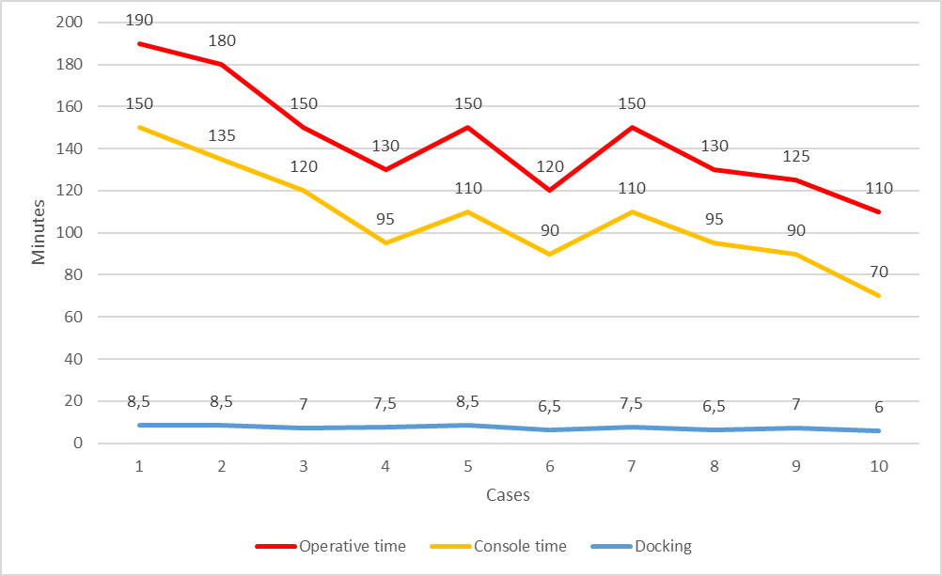
Early Experience and Results with the Hugo™ RAS Platform
From January 2023 to March 2023, we performed 10 Gastric Bypass:
Break point!
4-7 cases

Slide 19
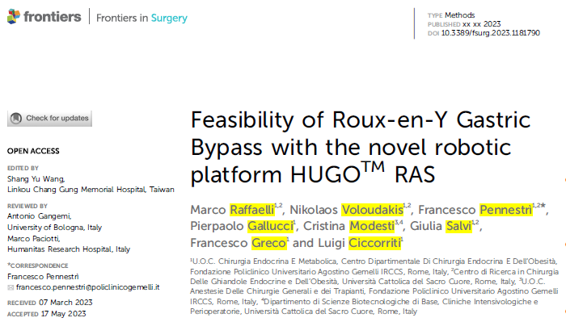
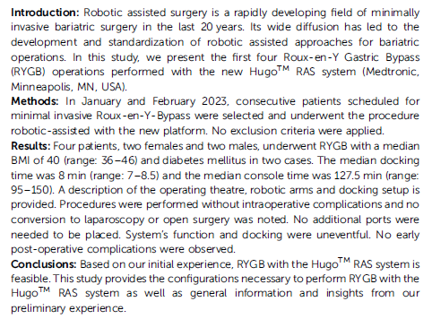
Hugo™ RAS System: personal experience

Slide 20
Surgeon | Bariatric | Urology | Total
Prof Raffaelli | 46 | 13 | 59
Dr Greco | 29 |  | 29
Dr Ciccoritti | 28 |  | 28
Dr. Giustacchini | 6 |  | 6
 | 109 | 13 | 122

Slide 21
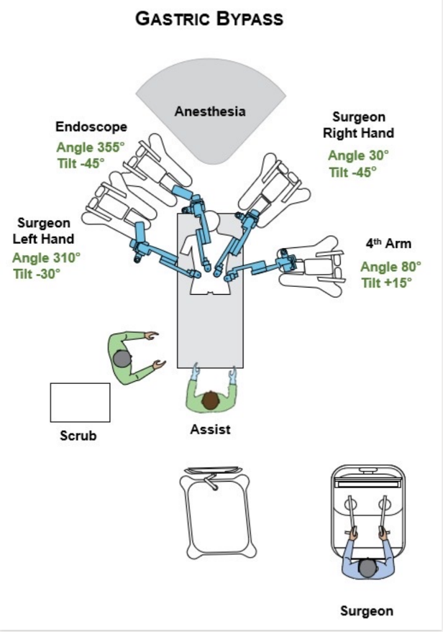
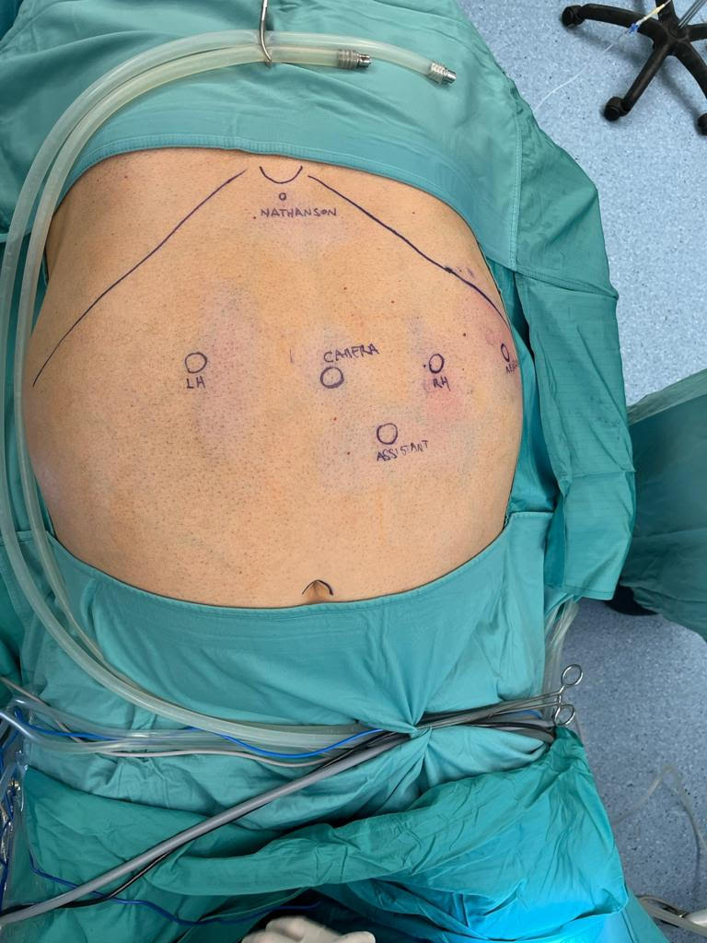

Slide 22
HUGOTM RAS
In our experience RYGB is feasible and safe with Hugo™ RAS Platform
Advantages:
  Vision for the surgical team
  Suturing
  Possibility to adapt position of a single arm in case of collision (!?!)
Disadvantages
  Manual docking
  Lack of hook, energy device, robotic stapler
  Need to ameliorate instruments
  (Robotic arms dimension – obstacle for anesthesiologists)

Slide 23
How to Improve the Hugo™ RAS Platform
Energy based device – Ligasure (to perform more dissection, for example in SADI-S)
ICG fluorescence (for vascularization)
Stapler
Ergonomic chair
Work in progress

Slide 24
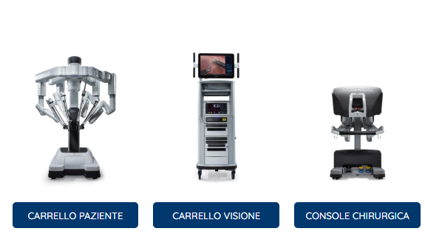
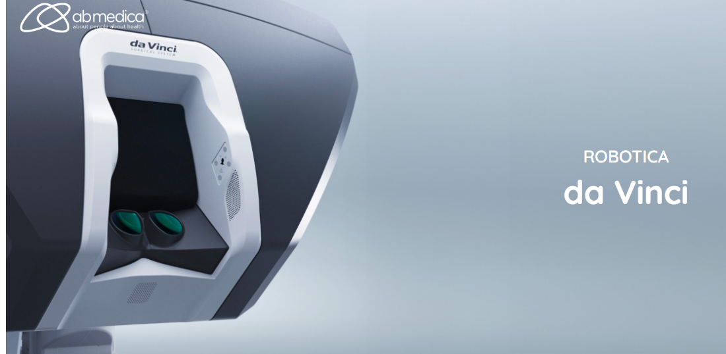
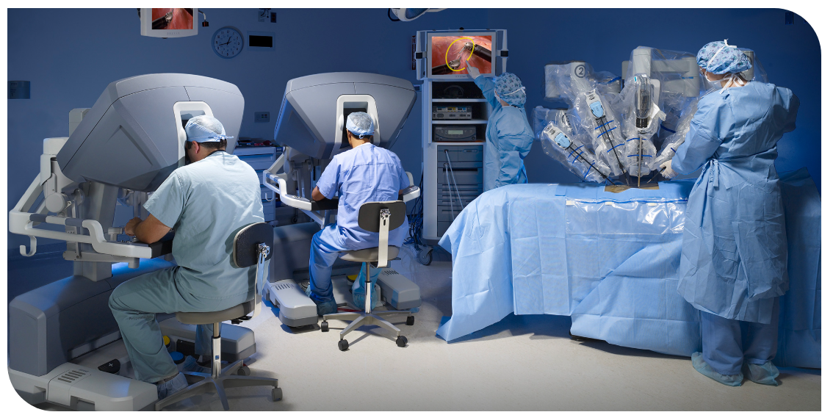

Slide 25
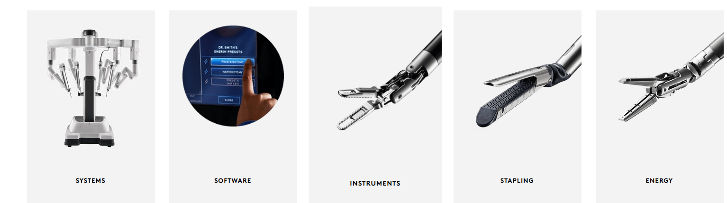
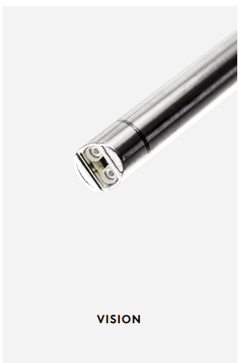

Slide 26
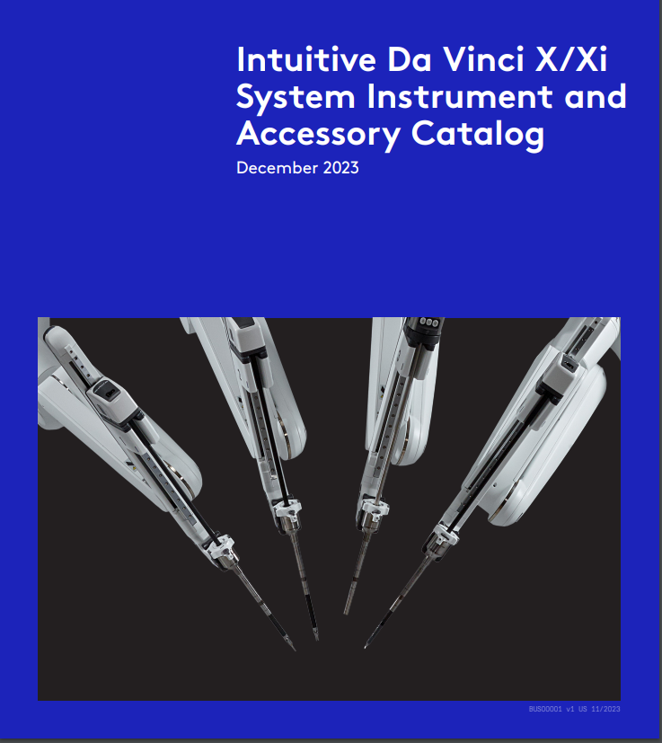
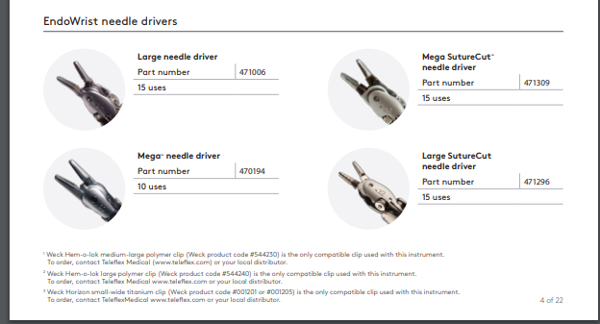
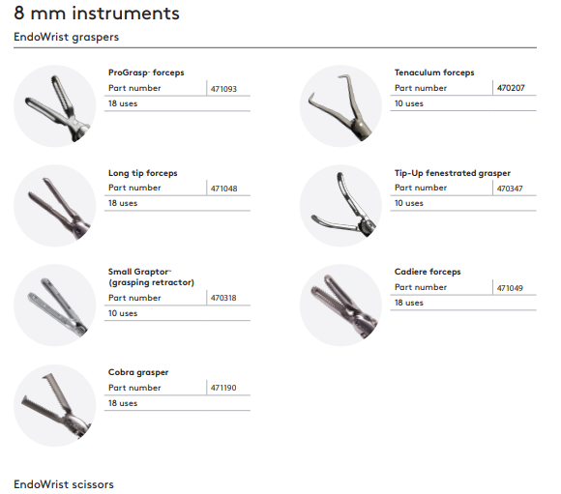
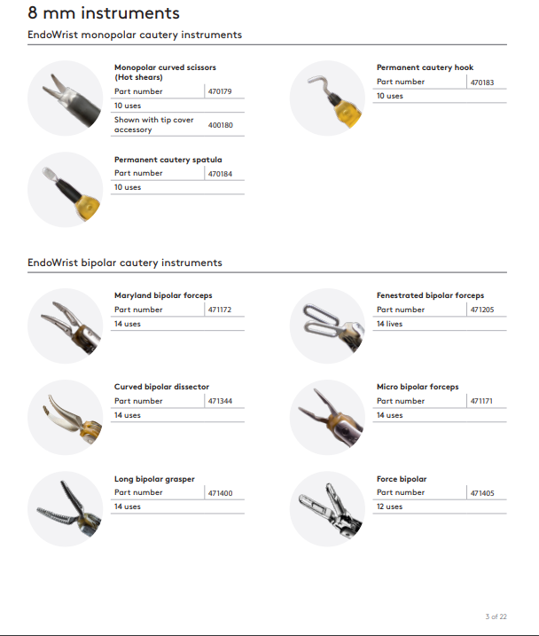

Slide 27
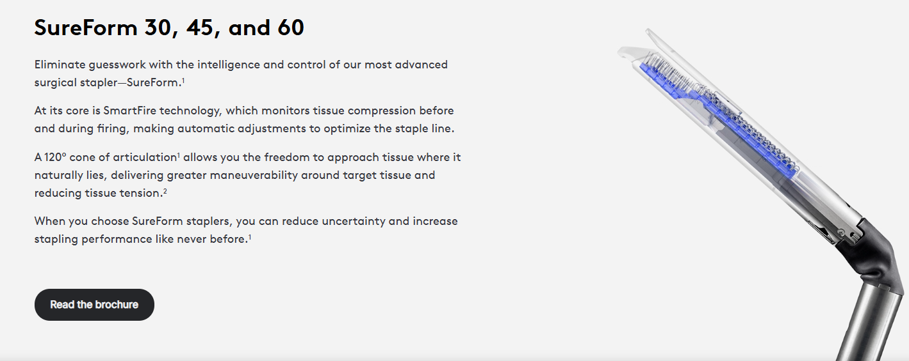
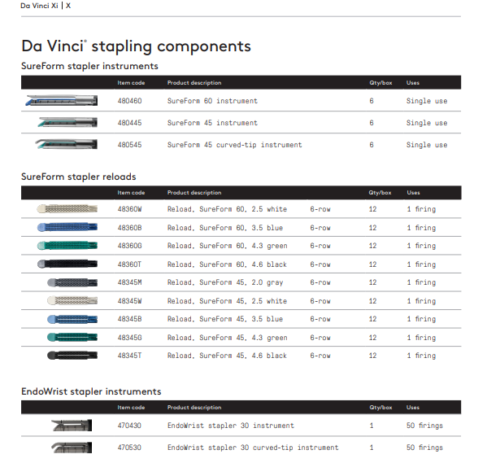

Slide 28
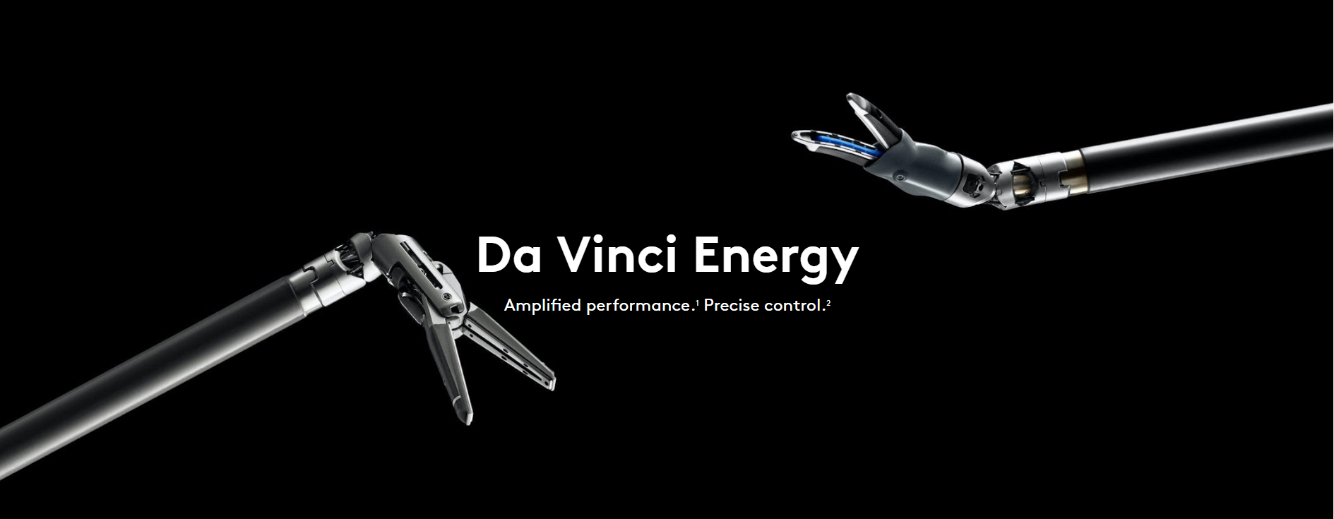
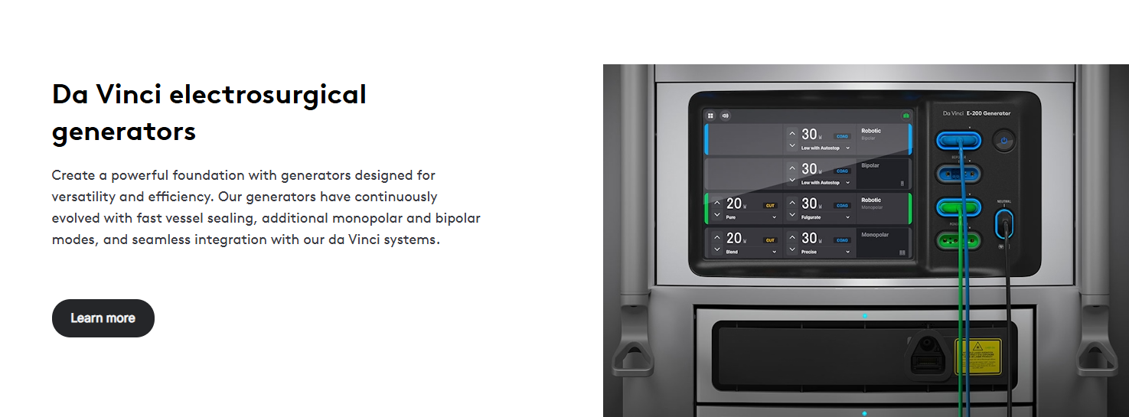

Slide 29
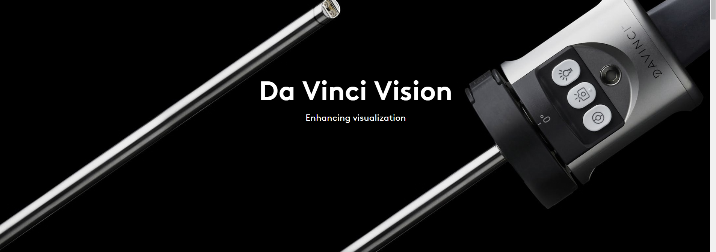
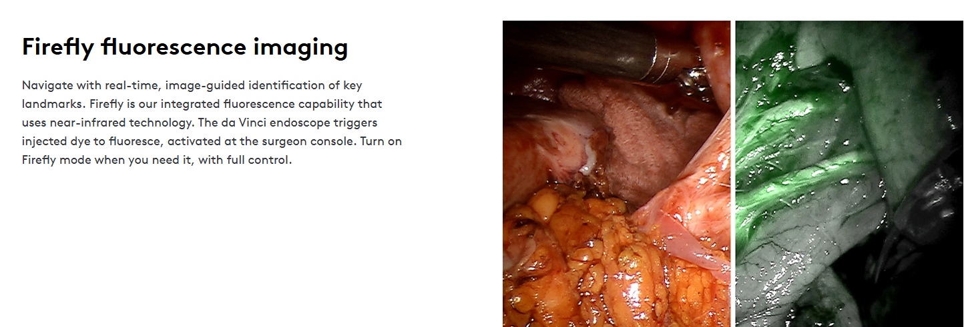

Slide 30
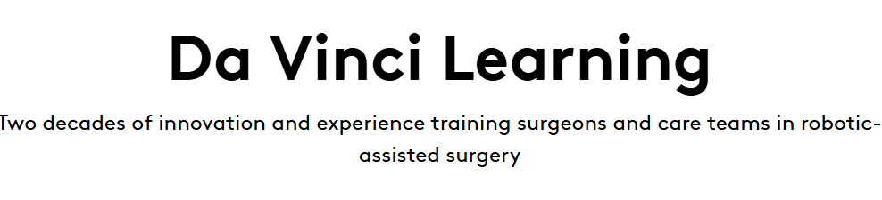
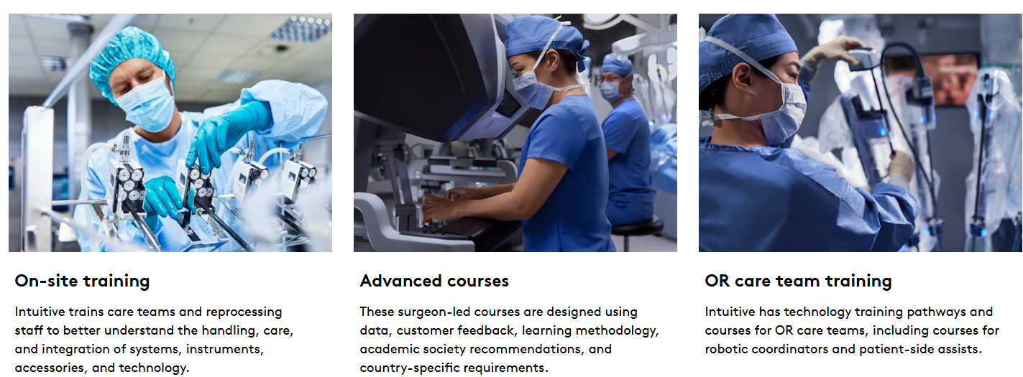


Slide 31
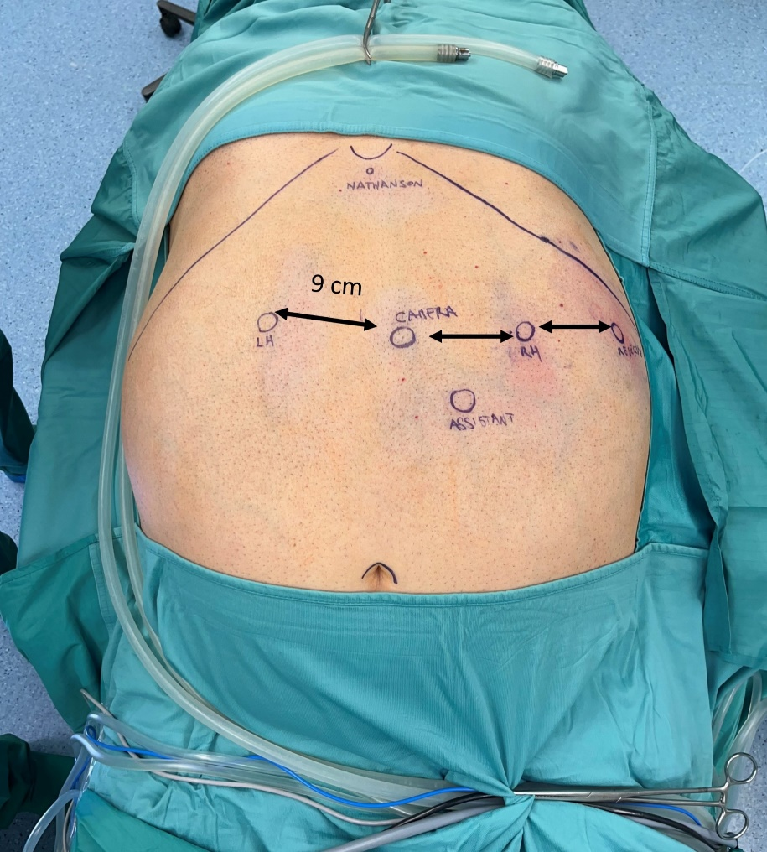
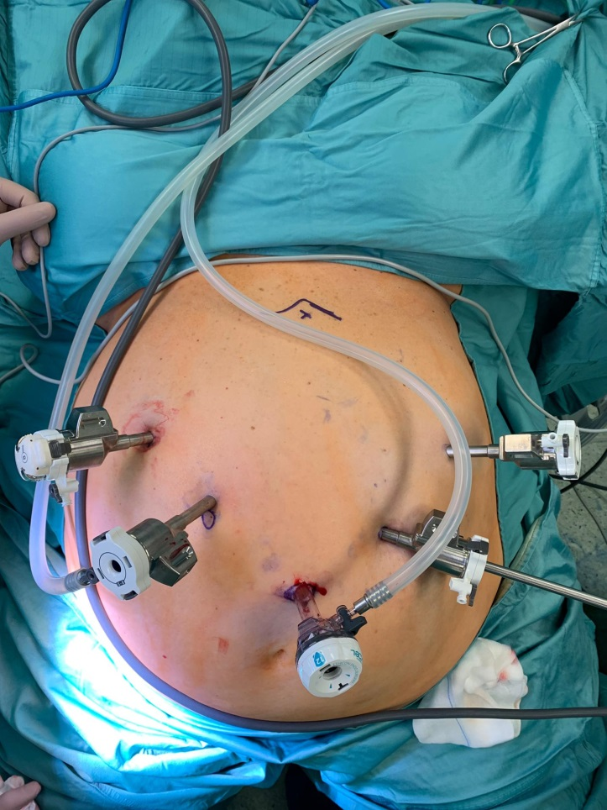
Bypass gastrico roux-en-y robotico (Da Vinci)
SADI-S (Da Vinci)

Slide 32
Bariatric Experience with HUGOTM RAS (Medtronic) – Gemelli Hospital
Robotic RYGB: Propensity score match analysis with two different platforms
(Hugo vs Da Vinci)
Table - Intraoperative and postoperative data: DaVinci vs Hugo, Post Match
Variable | DaVinci N= 32 | Hugo N= 32 | p-value
Operative time, min (mean ± SD) | 206.37 ± 69.69 | 166.56 ± 42.47 | 0.064
Time of Robotic Docking, min (mean ± SD) | 7.95 ± 0.92 | 7.35 ± 0.91 | 0.162
Post-operative ICU (n, %) | 2 | 1 | 0.554
Post-operative hospital stay, days (n, %) (Median, IQR) | 3 (2-7) | 2 (1 – 2) | 0.354
Postoperative total complications, (n, %) | 6 | 4 | 0.491

Slide 33
INDICAZIONI:
Super-obesi (BMI 50 kg/m²)
Pazienti maschi
Pregressa chirurgia addominale
PRIMARY SURGERY:
(SLEEVE )
(OAGB )
RYGB
SADI/SADIS
RE-DO SURGERY:
RYGB
SADI

Slide 34
DIVISION OF ENDOCRINE AND METABOLIC SURGERY
(03/2012 - 3/2025)
~ 6000 BARIATRIC PROCEDURES
5.5%

Slide 35
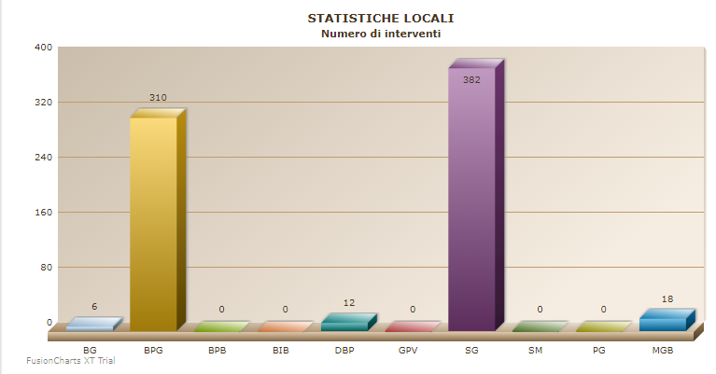
2024
731 bariatric procedures
140 ROBOTIC PROCEDURES (19,6%)

Slide 36




Slide 37
Role of robotics still to be defined:
- similar results
- increased costs
- better surgeon’s comfort
- more complex cases (?)
- learning curve

Slide 38
Does not eliminate the need for advanced laparoscopic skill
Need for training (even if usually short)
Very useful tool, at least in selected, challenging cases (Revisions, Superobese, etc)
Selective approach (use it, when you need it more)

Slide 39


Grazie

